Slide 1

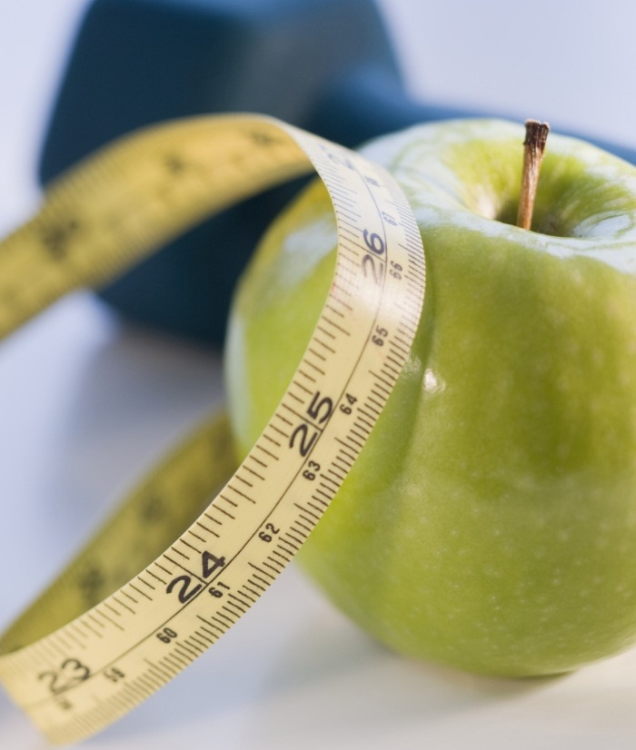
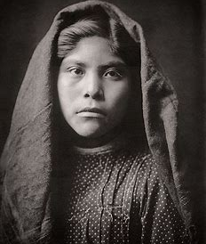
Pima Indians’ diabetic prediction
Entity Academy
Sindy saintclair

Slide 2
background
This dataset is originally from the National Institute of Diabetes and Digestive and Kidney Diseases. The objective of the dataset is to diagnostically predict whether or not a patient has diabetes, based on certain diagnostic measurements included in the dataset. Several constraints were placed on the selection of these instances from a larger database. All patients here are females at least 21 years old of Pima Indian heritage.
The dataset consists of several medical predictor variables and one target variable, Outcome. Predictor variables include the number of pregnancies the patient has had, their BMI, insulin level, age, glucose, blood pressure, triceps skin fold thickness (mm), and diabetes pedigree function.
I chose this dataset because it held 2 or more variables that I believe have a linear relationship of some importance. In this presentation, the assumption tests were completed, and a linear model was produced. The R-squared value was assessed to see if a linear relationship was present and if all assumptions were met in R/R Studio.

Slide 3
Examining if there is a linear relationship of some importance between two variables in the dataset
PART ONE

Slide 4
“age has no influence on the blood pressure readings of these select groups of Pima Indian women and vice versa.”
Null hypothesis:

Slide 5
Testing the assumptions
Part 1

Slide 6

Testing the assumptions
Linearity

Slide 7
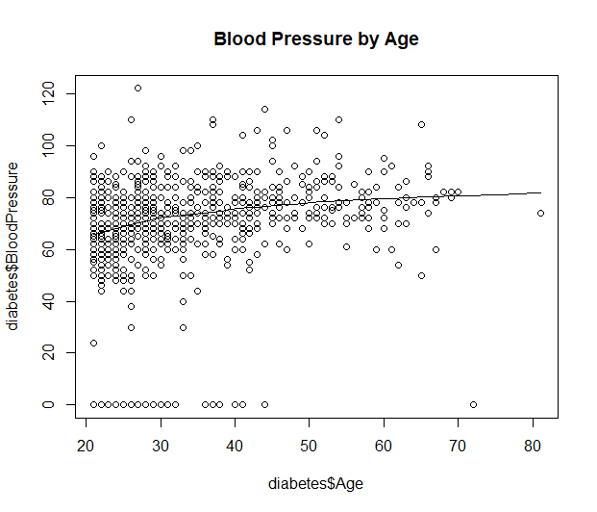
Linearity
There appears to be a linear relationship shown here in this scatterplot of blood pressure readings over different ages, however, most readings were condensed in the ages 20-36 years old and were also condensed between 40 to 85 in blood pressure.
Though not typically linear, a line is present. A cone shape is made as the number of readings decreases as the older patients get.
Higher blood pressure readings were more common among those in their early to mid-twenties, but a majority of 20-30-year-olds held normal blood pressure readings.
This could be due to the likelihood of the majority of data coming from a younger population and a lack of older populations participating in the collection of data.

Slide 8

Testing the assumptions
Homoscedasticity

Slide 9
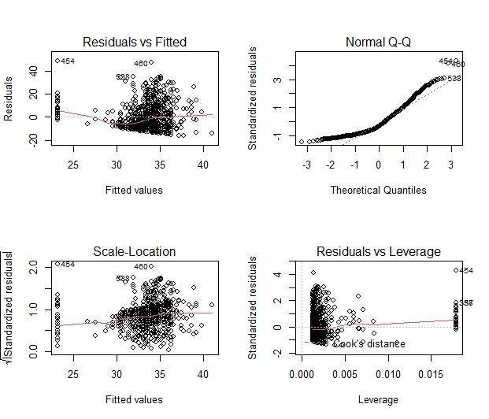
In terms of homoscedasticity…
According to the graphs on the left, the top left graph shows the fitted values against the residuals, while the bottom left shows the fitted values against eh standardized residuals.
Both graphs should show random points with a flat red line, straight across, if they are homoscedastic and thus meet the assumptions that allow the completion of linear regression.
There is a suspicious upward trend in my residuals, specifically in the bottom of the two left plots, which raises a red flag of heteroscedasticity.

Slide 10

Testing the assumptions
Homogeneity of Variance

Slide 11
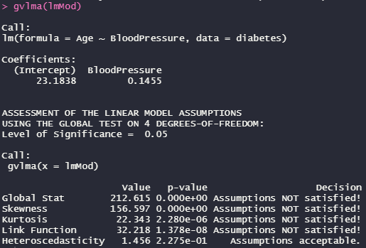
Testing for homogeneity of variance
When executing the Breusch Pagan test on the linear model created for this dataset, the p value was found to be greater than 0.05, deeming it homoscedastic.
But when we tested for homogeneity of variance, it was found that the linear model had assumptions acceptable for heteroscedasticity, contrary to the conclusion we came to prior.
I will explain what each measure of the homogeneity of variance for the linear model means on the next slide.

Slide 12
Testing for homogeneity of variance PT 2
Global Stat: This indicates whether the relationship between your x and y data is linear. - Assumptions NOT Satisfied, thus deeming this equation to not be a linear equation
Skewness: This is a measure of whether your data is normally distributed horizontally. - Assumptions NOT Satisfied
Kurtosis: This is an indicator of whether your data is normally distributed vertically - Assumptions NOT Satisfied
Link Function: This tests whether your variable is continuous. If this has been violated, then data is categorical and analyses such as logistic regression should be used instead. - Assumptions NOT Satisfied, so logistic regression would be best
Heteroscedasticity: This is an indicator of whether your residuals are constant. If you fail this, you fail the assumption of homoscedasticity discussed extensively above. - Assumptions acceptable, rendering this homoscedastic.

Slide 13
Screening for outliers
Test for distance, leverage, and influential outlier points
Part 2

Slide 14
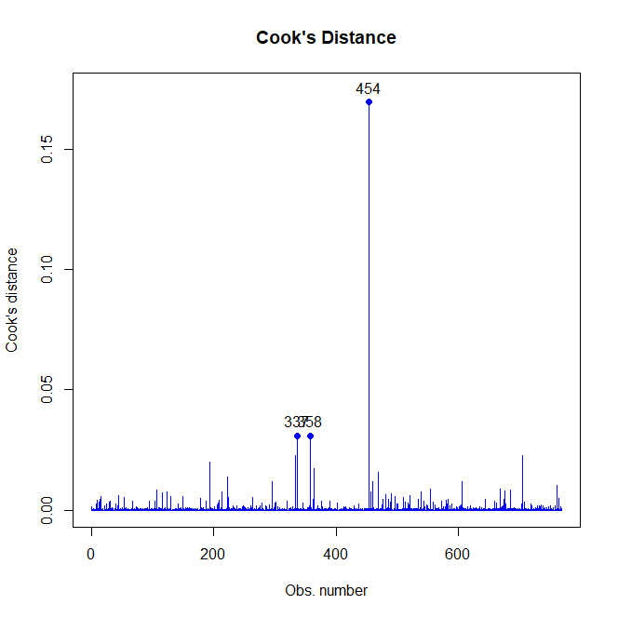
Finding the outliers in the model: Distance
Cook’s distance outlier graph
explanation
According to this graph produced in R Studio of Cook’s Distance—a way to find the major outliers to screen for in x space.
So, cases number 337, 358, and 454—with case 454 being the farthest outlier

Slide 15
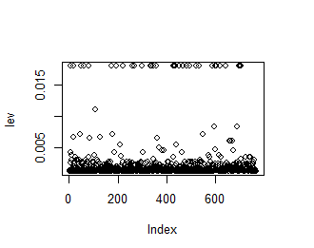
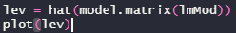
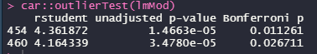
Finding the outliers in the model: leverage
Leverage values
explanation
When conducting a leverage outliers screening on the linear model, it was found that there was nothing over 0.2 (anything with a leverage value of between 0.2 and 0.5 is a moderate problem and anything over 0.5 is a major problem)
When testing for outliers in y space, we test for the furthest outlier. If the Bonferroni p-value is significant (less than 0.05), then there is an outlier. With rstudent values over 2.5 or 3, there are problems with outliers in y space. Here, the values are well over 3, deeming cases 454 and 460 outliers in y space.

Slide 16
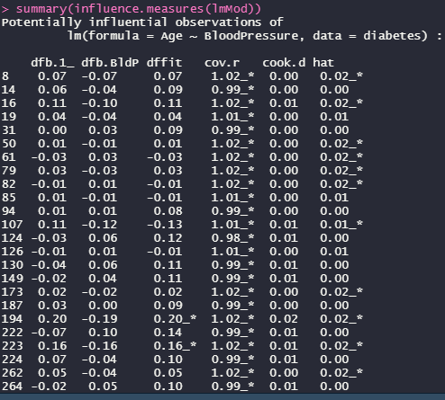
Finding the outliers in the model: influence
Testing for outliers in x and Y space
explanation
Two metrics to examine: DFFITS and DFBETAS
If a DFFITS or DFBETAS value is greater than 1, than there is an influential outlier.
Luckily, for us there were no influential outliers

Slide 17
Running simple linear regression & Interpreting output
Part 3

Slide 18
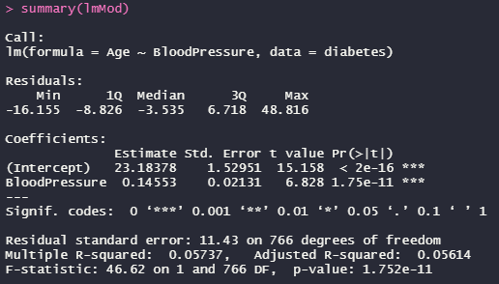
Getting a summary of the linear model
First, look at the F statistic. The larger the F statistic, the more likely it is to be significant. What confirms this high F statistic, is that the P value is less than 0.05 - a second indicator of the linear model's significance.
The slope was quite close to zero, at 0.14553. Because the linear model was considered significant, we can reject the null hypothesis that the Age of many Pima Indian women does not influence their Blood Pressure, an additional complication of having diabetes.
We can also take from the data that as these women age, the more stabilized their blood pressure readings become. However, there is a high concentration of medium to high blood pressure readings for those between the ages of 20-40 years old, indicating that there may be other factors attributed to this concentration and instances of hypertension in the Pima Indian women community.

Slide 19
Performing logistic regression on 1 variable that is a binary classification and one continuous variable that may influence it.
Part two

Slide 20
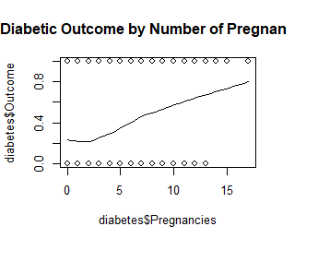
Scatterplot
From what can be seen here in this scatterplot of the diabetic outcome by the number of pregnancies, there isn’t much of a linear relationship, thus encouraging me to attempt logistic regression on these two variables—the diabetic outcome being binary classification and the number of pregnancies being continuous.

Slide 21

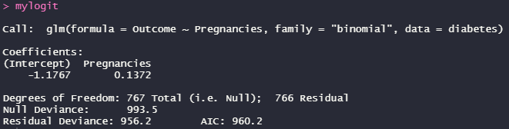
Creating a logistic regression model
The code to the left ultimately creates the logistic model for the binary classification variable which is the diabetic outcome vs the number of pregnancies per Pima Indian woman.

Slide 22
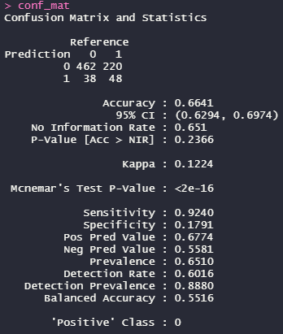
Creating a confusion matrix
According to this confusion matrix, out of the sample size of Pima Indian women studied that were predicted to not have acquired diabetes, 462 did not in actuality acquire diabetes, whereas 220 of them did acquire diabetes despite predictions that they wouldn't.
Out of the sample size of Pima Indian women studied, 38 of those that were predicted to have acquired diabetes did not whereas 48 of those predicted to have diabetes acquired it.
Roughly 66% of the time, my predictions are correct.

Slide 23
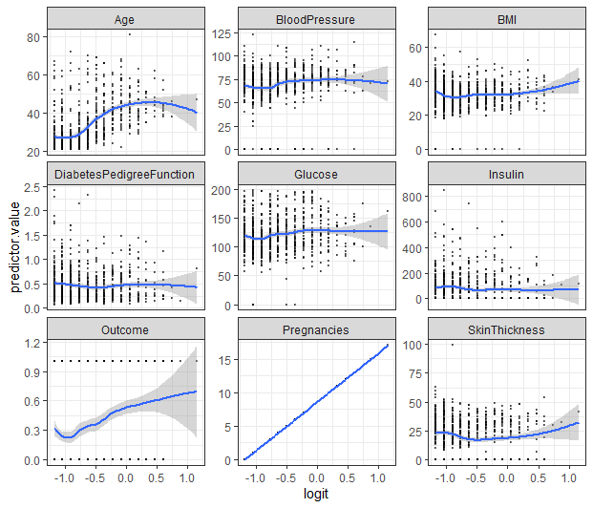
Graphing using ggplot: Logistic regression model of all predictor values
As you can see from the multitude of graphs plotted, pregnancies exhibited a highly linear relationship with being diagnosed with Diabetes. This graph shows that as the number of pregnancies increases, so does their likelihood of being diagnosed with diabetes—a strong linear relationship.

Slide 24
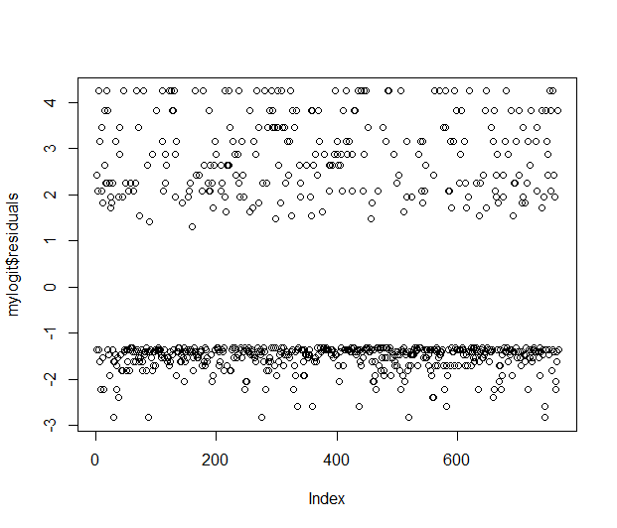
Graphing the errors
This has not met the assumption for independent error entirely due to there not being an entirely even distribution at the top or the bottom.

Slide 25
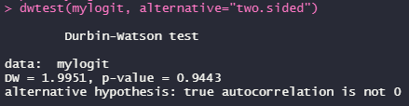
Calculating error using the Durbin-Watson test
Not significant due to the large p-value (greater than 0.05), so we have met the assumption of having no independent errors.

Slide 26
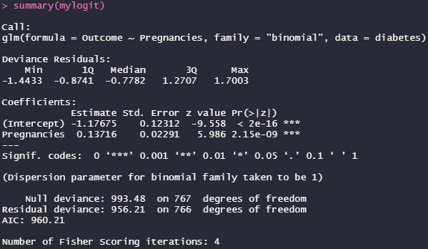
Summary of the logistic model
So, the number of pregnancies is a significant predictor of the outcome of diabetes, due to the significant p values associated with the intercept and pregnancy coefficients.

Slide 27
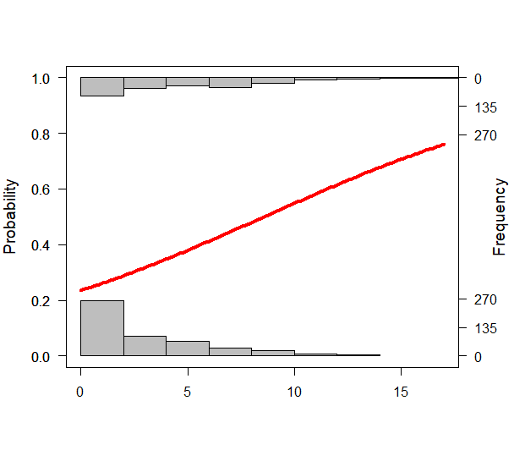
Logistic regression model graphed and plotted
From what this logistic model displays and the previous slide, one can infer that the number of pregnancies was significant enough to contribute to the outcome of whether a Pima Indian woman patient would have diabetes or not.
So, it is presumed that for each pregnancy, you see that the log odds of acquiring diabetes (versus not acquiring it) are increased by 0.137 or 13.7%.
Some women in the Pima Indians have up to 10 children, increasing their chances of acquiring diabetes to 137%!

Slide 28

Multiple logistic regression
Where we will analyze all the predictor variables’ relationships with the target variable, the Outcome.

Slide 29
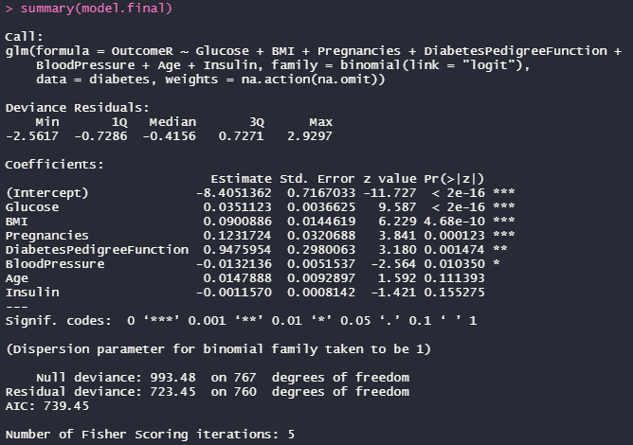
Summary of multiple logistic regression model
Glucose, BMI, Pregnancies, Diabetes Pedigree Function, and Blood Pressure all have a significant impact on the outcome of whether these Pima Indian women will have diabetes.
Insulin and Age are not significant factors in determining whether these Pima Indian women will have diabetes because the p values for these coefficients are more than 0.05.

Slide 30
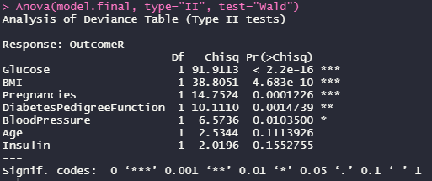
ANOVA
According to this ANOVA, Glucose, BMI, Pregnancies, Diabetes Pedigree Function, and Blood pressure held significance in determining the outcome in predicting diabetes in these Pima Indian women patients—in order of most significant to least.

Slide 31
Create a quadratic and exponential model and assess which of the 3 models fit best
Part three

Slide 32
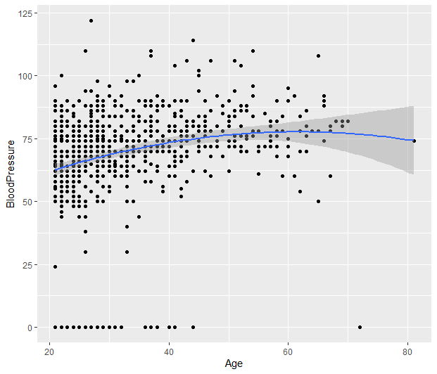
Is the model quadratic in nature?
Looks like the quadratic line is a pretty good fit for the data!
Especially since the line forms a bow instead of a straight line or any other line of that nature.

Slide 33
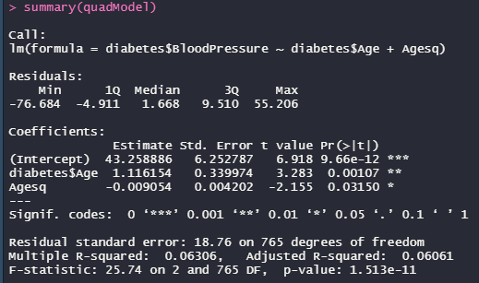
Modeling the quadratic relationship
explanation
R Studio output of the quadratic model summary after creating the model
Looking at the F statistic and the p-value of this model, this model has been deemed significant, meaning that Age does play a quadratic role in how high or low these Pima Indian women's blood pressure readings are.

Slide 34
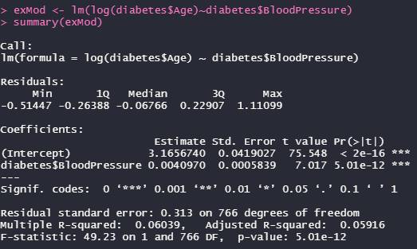
Producing an exponential model
The F statistic and the p-value exhibits signs of significance, meaning that there is an exponential relationship between blood pressure and age. When examining the estimate column, the blood pressure of the Pima Indian women increased by 0.4%.

Slide 35
Which of these models best fit?
The Linear model, the quadratic model, or the exponential model

Slide 36
The quadratic model
Because the adjusted the R squared value of the quadratic model was the highest out of all three models, it would be considered the most fitting of all three to model the relationship between age and blood pressure.

Slide 37

Thank you
Sindy saintclair

